Slide 1
Scope and Activation Records
CS 345
Vitaly Shmatikov
slide <number>

Slide 2
Activation Records for Functions
Block of information (“frame”) associated with each function call, including:
  Parameters
  Local variables
  Return address
  Location to put return value when function exits
  Control link to the caller’s activation record
  Saved registers
  Temporary variables and intermediate results
  (not always) Access link to the function’s static parent
slide <number>

Slide 3
Activation Record Layout
Control link
Return address
  Location of code to execute on function return
Return-result address
  Address in activation record of calling block to receive returned value
Parameters
  Locations to contain data from calling block
Return address
Return-result addr
Parameters
Local variables
Intermediate results
Environment pointer
slide <number>

Slide 4
Example
Function
  fact(n) = if n<=1 then 1
  else n * fact(n-1)
  Return result address:
  location to put fact(n)
Parameter
  Set to value of n by calling sequence
Intermediate result
  Locations to contain value of fact(n-1)
Control link
Return address
Return result addr
Parameters
Local variables
Intermediate results
Environment pointer
slide <number>

Slide 5
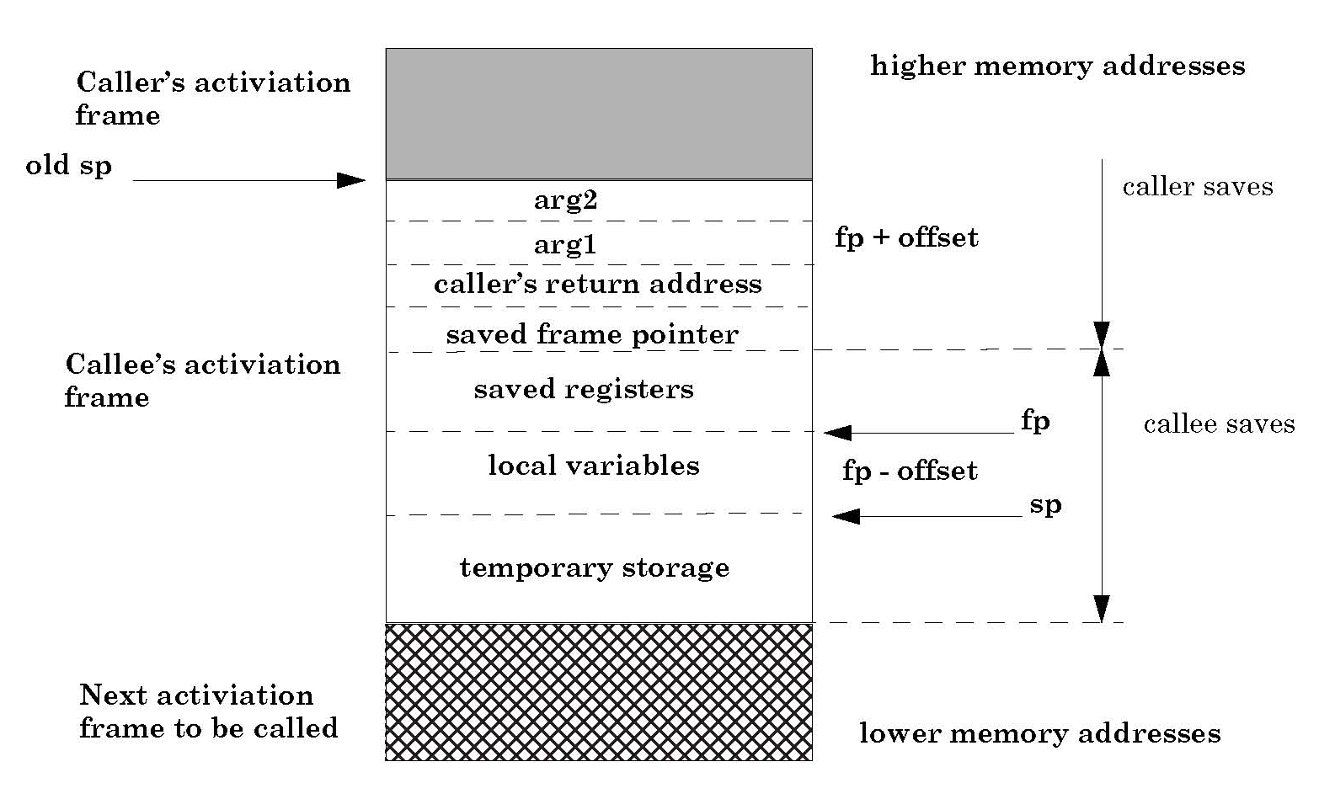
Typical x86 Activation Record
frame pointer
stack pointer
slide <number>

Slide 6
Run-Time Stack
Activation records are kept on the stack
  Each new call pushes an activation record
  Each completing call pops the topmost one
  Stack has all records of all active calls at any moment during execution (topmost record = most recent call)
Example: fact(3)
  Pushes one activation record on the stack, calls fact(2)
  This call pushes another record, calls fact(1)
  This call pushes another record, resulting in three activation records on the stack
slide <number>

Slide 7
Function Call
fact(k)
fact(3)
Control link
Control link
Return-result addr
Return-result addr
n
k
n
3
fact(n-1)
fact(n-1)
fact(2)
Control link
Environment pointer
Return-result addr
n
2
fact(n-1)
fact(1)
Control link
  fact(n) = if n<= 1 then 1
  else n * fact(n-1)
Return-result addr
n
1
Return address omitted; would be a pointer into code segment
fact(n-1)
slide <number>

Slide 8
Function Return
fact(3)
Control link
fact(3)
Control link
High
addresses
Return-result addr
Return-result addr
n
3
n
3
fact(n-1)
fact(n-1)
2
fact(2)
Control link
fact(2)
Control link
Return-result addr
Return-result addr
n
2
n
2
fact(n-1)
1
fact(n-1)
1
fact(1)
Control link
Return-result addr
  fact(n) = if n<=1 then 1
  else n * fact(n-1)
Low
addresses
n
1
fact(n-1)
slide <number>

Slide 9
Scoping Rules
Global and local variables
  x, y are local to outer block
  z is local to inner bock
  x, y are global to inner block
  { int x=0;
  int y=x+1;
  { int z=(x+y)*(x-y);
  };
  };
Static scope
  Global refers to declaration in closest enclosing block
Dynamic scope
  Global refers to most recent activation record
Do you see the difference? (think function calls)
slide <number>

Slide 10
Static vs. Dynamic Scope
Example
  var x=1;
  function g(z) { return x+z; }
  function f(y) {
  var x = y+1;
  return g(y*x);
  }
  f(3);
outer block
x
1
f(3)
y
3
x
4
g(12)
z
12
Which x is used for expression x+z ?
static scope
dynamic scope
slide <number>

Slide 11
Activation Record For Static Scope
Control link
  Link to activation record of previous (calling) block
  Depends on dynamic behavior of the program
Access link
  Link to activation record of closest lexically enclosing block in program text
    Is this needed in C? (why?)
  Depends on the static program text
Control link
Access link
Return address
Return result addr
Parameters
Local variables
Intermediate results
Environment pointer
slide <number>

Slide 12
Complex Nesting Structure
  function m(…) {
  var x=1;
  …
  function n( … ){
  function g(z) { return x+z; }
  …
  { …
  function f(y) {
  var x = y+1;
  return g(y*x); }
  …
  f(3); … }
  … n( … ) …}
  … m(…)
  var x=1;
  function g(z) { return x+z; }
  function f(y)
  { var x = y+1;
  return g(y*x); }
  f(3);
Simplify to
Simplified code has same block nesting, if we follow convention that each declaration begins a new block
slide <number>

Slide 13
Static Scope with Access Links
outer block
x
1
  var x=1;
  function g(z) = { return x+z; }
  function f(y) =
  { var x = y+1;
  return g(y*x); }
  f(3);
control link
access link
g
…
control link
access link
f
…
f(3)
control link
access link
Use access link to find global variable:
- Access link is always set to frame of
closest enclosing lexical block
- For function body, this is the block that
contains function definition
y
3
x
4
g(12)
control link
access link
z
slide <number>
12

Slide 14
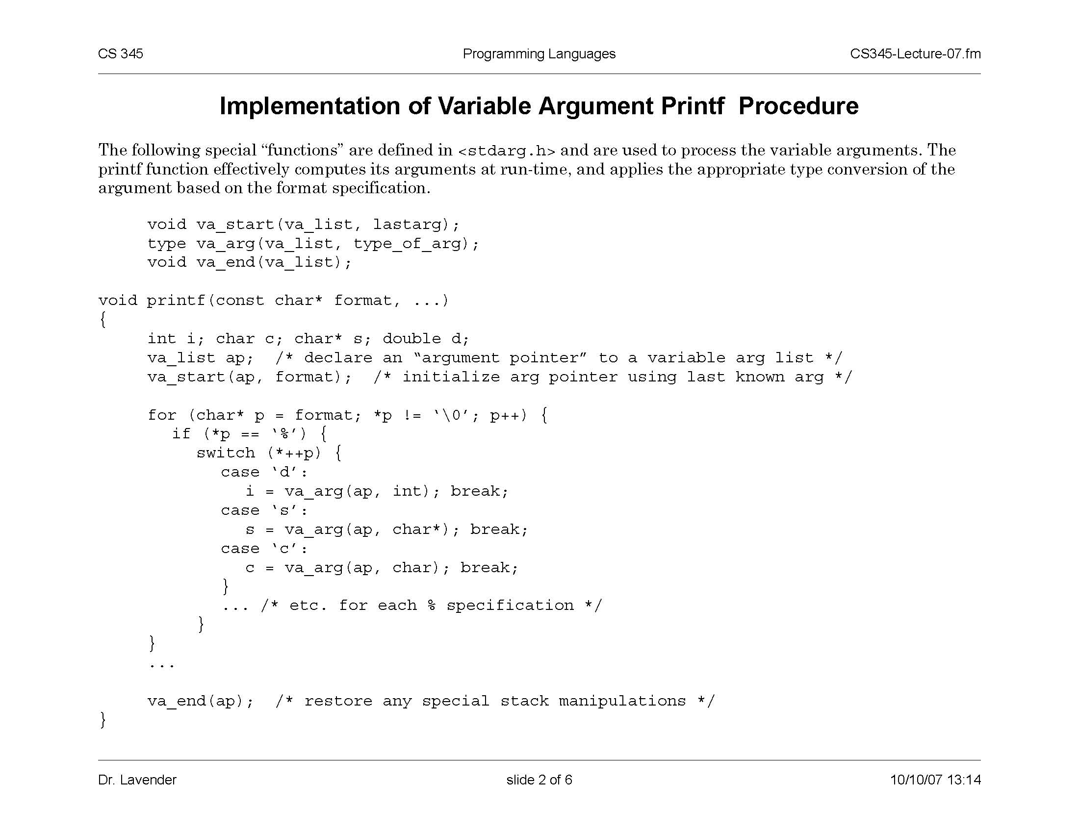
Variable Arguments (Redux)
Special functions va_start, va_arg, va_end compute arguments at run-time (how?)
slide <number>

Slide 15
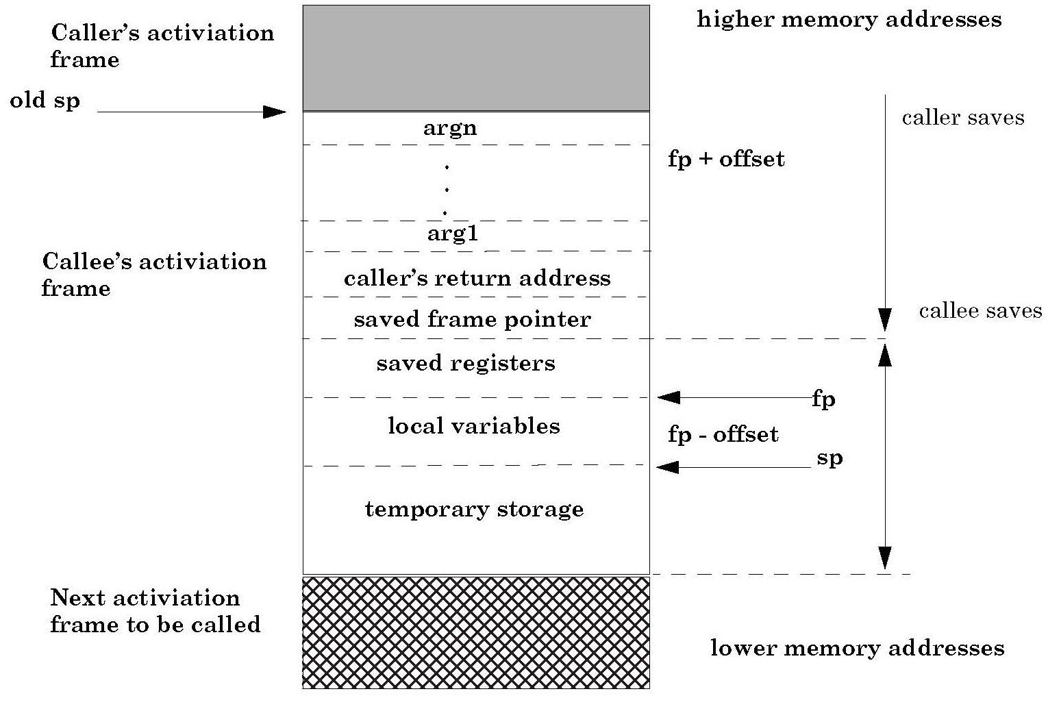
Activation Record for Variable Args
va_arg(ap,type)
retrieves next arg
from offset ap
va_start computes
location on the stack
past last statically
known argument
slide <number>

Slide 16
Tail Recursion (first-order case)
Function g makes a tail call to function f if return value of function f is return value of g
Example
  fun g(x) = if x>0 then f(x) else f(x)*2
Optimization: can pop current activation record on a tail call
  Especially useful for recursive tail call because next activation record has exactly same form
tail call
not a tail call
slide <number>

Slide 17
Example of Tail Recursion
Calculate least power of 2 greater than y
f(1,3)
control
control
Optimization
  Set return value address to that of caller
  Can we do same with control link?
Optimization
  Avoid return to caller
  Does this work with dynamic scope?
return val
return val
x
1
x
1
y
3
y
3
control
return val
  fun f(x,y) = if x>y
  then x
  else f(2*x, y);
  f(1,3) + 7;
x
2
y
3
control
return val
x
4
y
3
slide <number>

Slide 18
Tail Recursion Elimination
f(1,3)
f(2,3)
f(4,3)
control
control
control
return val
return val
return val
x
1
x
2
x
4
y
3
y
3
y
3
Optimization
  pop followed by push - reuse activation record in place
  Tail recursive function is equivalent to iterative loop
  fun f(x,y) = if x>y
  then x
  else f(2*x, y);
  f(1,3) + 7;
slide <number>

Slide 19
Tail Recursion and Iteration
f(1,3)
f(2,3)
f(4,3)
control
control
control
return val
return val
return val
x
1
x
2
x
4
y
3
y
3
y
3
  fun f(x,y) = if x>y
  then x
  else f(2*x, y);
  f(1,y);
test
  function g(y) {
  var x = 1;
  while (!x>y)
  x = 2*x;
  return x;
  }
loop body
initial value
slide <number>

Slide 20
Higher-Order Functions
Function passed as argument
  Need pointer to activation record “higher up” in stack
Function returned as the result of function call
  Need to keep activation record of the returning function (why?)
Functions that take function(s) as input and return functions as output are known as functionals
slide <number>

Slide 21
Pass Function as Argument
  val x = 4;
  fun f(y) = x*y;
  fun g(h) = let
  val x=7
  in
  h(3) + x;
  g(f);
  There are two declarations of x
  Which one is used for each occurrence of x?
  { var x = 4;
  { function f(y) {return x*y;}
  { function g(h) {
  var x = 7;
  return h(3) + x;
  }
  g(f);
  } } }
slide <number>

Slide 22
Static Scope for Function Argument
  val x = 4;
  fun f(y) = x*y;
  fun g(h) =
  let
  val x=7
  in
  h(3) + x;
  g(f);
x
4
Code
for f
f
g
Code
for g
g(f)
h
x
7
h(3)
y
3
x * y
local var
follow access link
  How is access link for h(3) set?
slide <number>

Slide 23
Closures
Function value is pair closure = ⟨env, code ⟩
  Idea: statically scoped function must carry a link to its static environment with it
  Only needed if function is defined in a nested block (why?)
When a function represented by a closure is called…
  Allocate activation record for call (as always)
  Set the access link in the activation record using the environment pointer from the closure
slide <number>

Slide 24
Function Argument and Closures
  Run-time stack with access links
  val x = 4;
  fun f(y) = x*y;
  fun g(h) =
  let
  val x=7
  in
  h(3) + x;
  g(f);
x
4
Code
for f
access
f
access
g
Code
for g
g(f)
access
h
x
7
h(3)
access
access link set from closure
y
3
slide <number>

Slide 25
Summary: Function Arguments
Use closure to maintain a pointer to the static environment of a function body
When called, set access link from closure
All access links point “up” in stack
  May jump past activation records to find global vars
  Still deallocate activation records using stack (last-in-first-out) order
slide <number>

Slide 26
Return Function as Result
Language feature (e.g., ML)
Functions that return “new” functions
  Example: fun compose(f,g) = (fn x => g(f x));
  Function is “created” dynamically
    Expression with free variables; values determined at run-time
  Function value is closure = ⟨env, code⟩
  Code not compiled dynamically (in most languages)
  Need to maintain environment of the creating function (why?)
slide <number>

Slide 27
Return Function with Private State
  fun mk_counter (init : int) =
  let val count = ref init
  fun counter(inc:int) =
  (count := !count + inc; !count)
  in
  counter
  end;
  val c = mk_counter(1);
  c(2) + c(2);
  Function to “make counter” returns a closure
  How is correct value of count determined in c(2) ?
slide <number>

Slide 28
Function Results and Closures
  fun mk_counter (init : int) =
  let val count = ref init
  fun counter(inc:int) =
  (count := !count + inc; !count)
  in
  counter
  end;
  val c = mk_counter(1);
  c(2) + c(2);
mk_c
Code for
mk_counter
access
c
1
mk_counter(1)
access
3
init
1
count
counter
Call changes cell value from 1 to 3
c(2)
access
Code for
counter
inc
2
slide <number>

Slide 29
Closures in Web Programming
Useful for event handlers
function AppendButton(container, name, message) {
var btn = document.createElement('button');
btn.innerHTML = name;
btn.onclick = function(evt) { alert(message); }
container.appendChild(btn);
}
Environment pointer lets the button’s click handler find the message to display
slide <number>

Slide 30
Managing Closures
Closures as used to maintain static environment of functions as they are passed around
May need to keep activation records after function returns (why?)
  Stack (last-in-first-out) order fails! (why?)
Possible “stack” implementation:
  Put activation records on heap
  Instead of explicit deallocation, invoke garbage collector as needed
    Not as totally crazy as is sounds (may only need to search reachable data)
slide <number>

